Slide 1
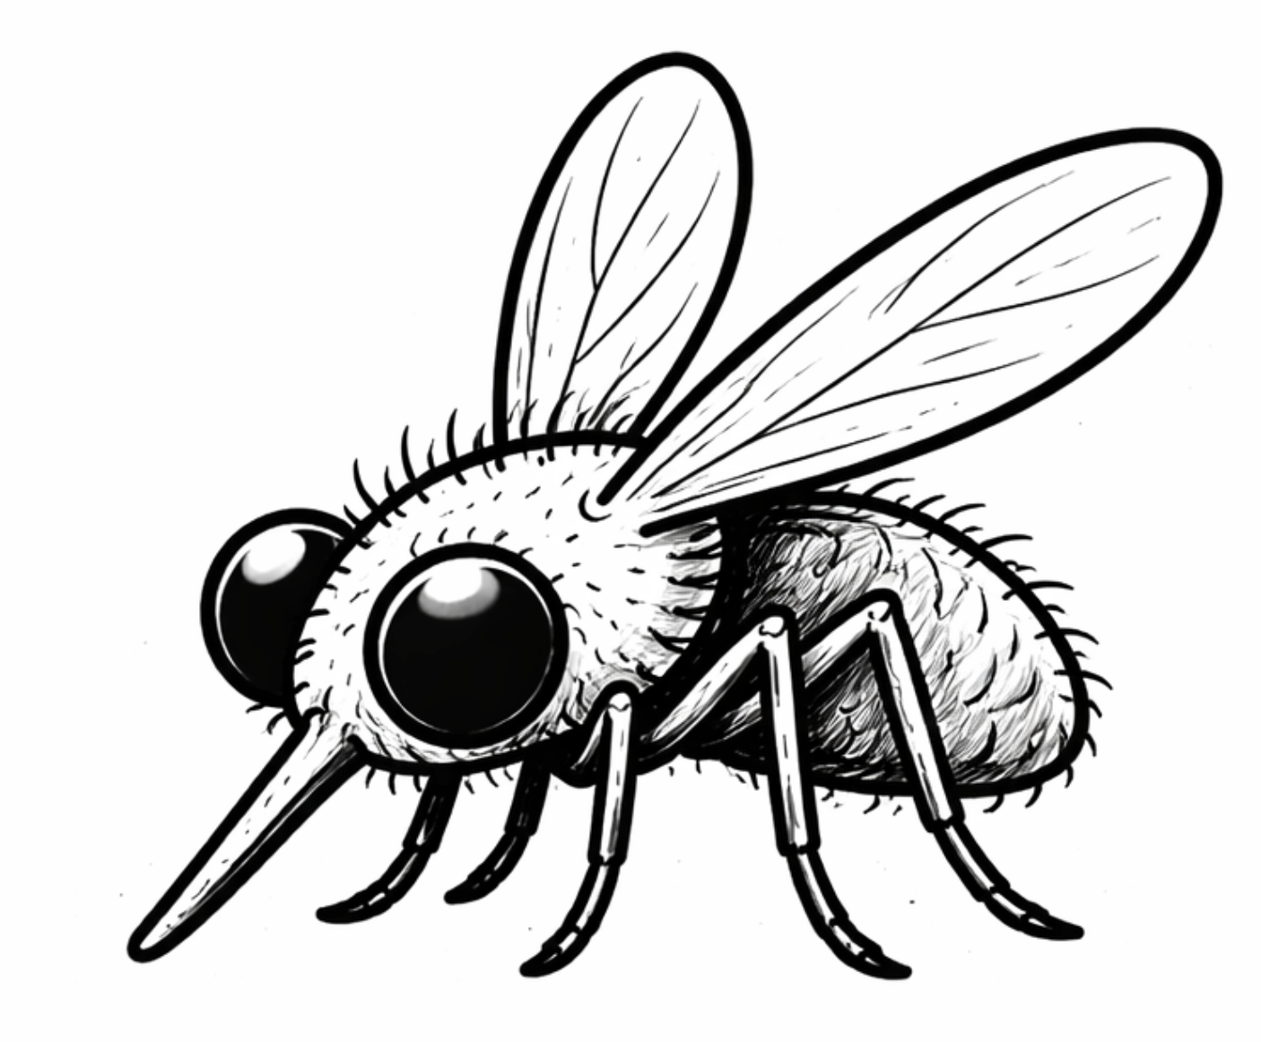
ASYMPTOMATIC
STAGE
SYMPTOMATIC
STAGE
Rx
POST-TREATMENT
STAGE
Death
Death
Relapse
Poor clinical response
Parasite
load
Initial treatment response
Immune escape
Worsening symptoms
Critical parasite load
Early immune control
Cure
Incubation period
~ weeks-months
Fever/symptom duration
~ 10-200 days
Rx
1-30 days
Time
Inoculation

